Slide 1
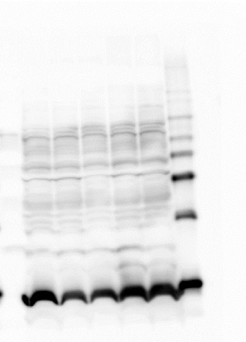
Figure 4C
H3

Slide 2
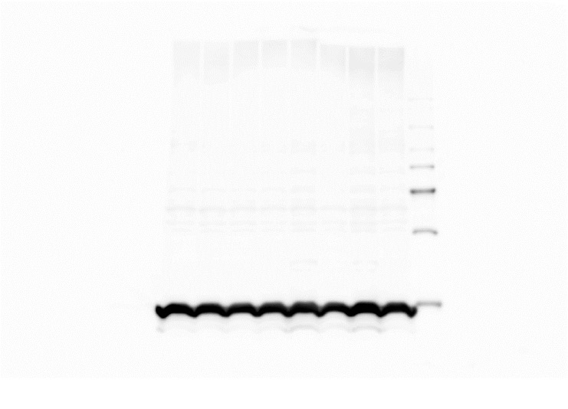
Figure 6E
H3

